Slide 1
Photography

Slide 2
What is Photography
the word photography literally means "light-writing," although a more accurate description would be "light-drawing.“
Can be considered as both Science and Art
What is a Camera
Camera obscura. a dark room (or box) with a small hole in one side, through which an inverted image of the view outside is projected onto the opposite wall, screen, or mirror. The image is then traced.

Slide 3
Purpose
The essential purpose of photography is communication. Few people take pictures solely to please themselves. Most of us take them because we want them to be seen by others as a profession. But pictures are a photographer's means of expression as a writer's means are words.

Slide 4
Basic Aesthetics in Photography
When we talk about aesthetics, we mean that some things are generally more pleasing to the eye—whether it be in a photograph, painting, or sculpture. The difference between a photographer and anybody else is not their ability to notice beauty, it is that the photographer should also be able to explain why some elements are pleasing while others are not. The understanding of aesthetics are ingrained in everybody. Anyone can see them, but only few can actually analyze a picture and are able to explain the compositional techniques to create a beautiful picture.

Slide 5
Compositional Rules
Such techniques are not “invented” by some expert painters, they were discovered in many different disciplines like photography, paintings, architecture, mathematics, and even in the arrangement of flowers. We can apply some of the below mentioned universal rules to create pictures that, visually speaking, most human beings will find harmonic.
Leading Lines
Rule of Third
Triangles
Rule of Odds
Breaking Symmetry

Slide 6
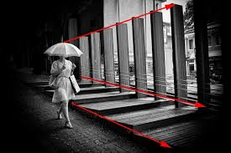
Leading Lines
The viewer’s eye is automatically led by lines and other geometrical figures. Leading lines help to put an emphasis on the subject, making them the center of attention. If the natural eye movement can follow these lines and ends up on the subject, it gives a very harmonic impression. Conversely, fighting against this flow can be very stressful.

Slide 7
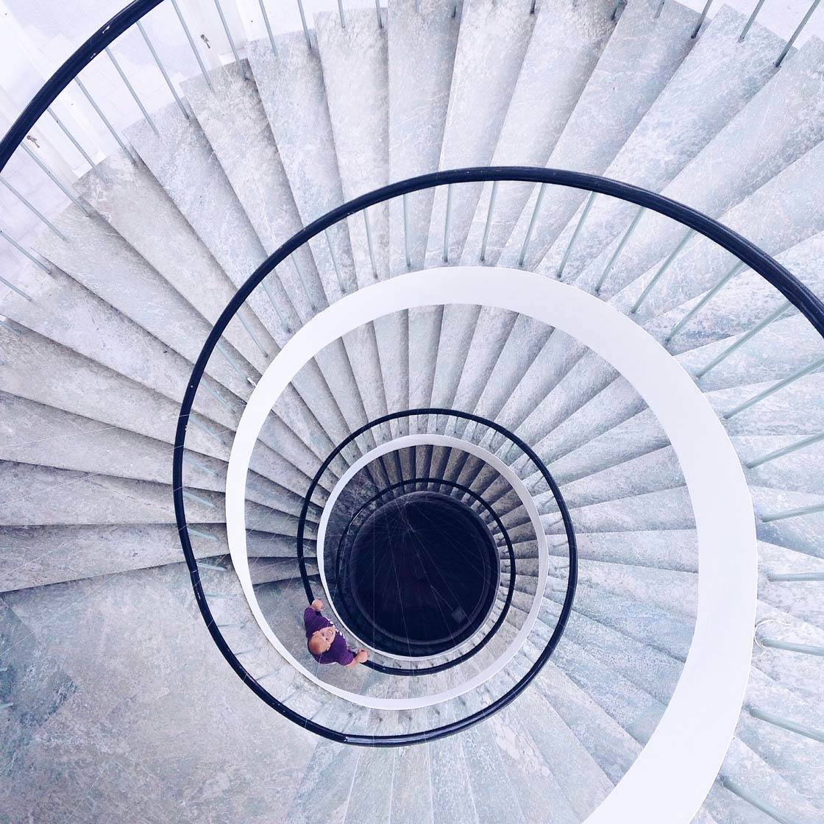

Slide 8
Rule of Third
Slightly different than the golden ratio, the rule of thirds is an approximation and divides the image in three areas. It is often more pleasing to place the subject slightly off-center. This is not only meant in a horizontal aspect, meaning from left to right, but also in the vertical gradient from bottom to top.
This leaves us with four intersections (top left, top right, bottom left, bottom right) where we want to place our subject “ideally.” In Street Photography, using the top coordinates allows us to show more from the subject, making them the most preferable points to focus our attention.

Slide 10
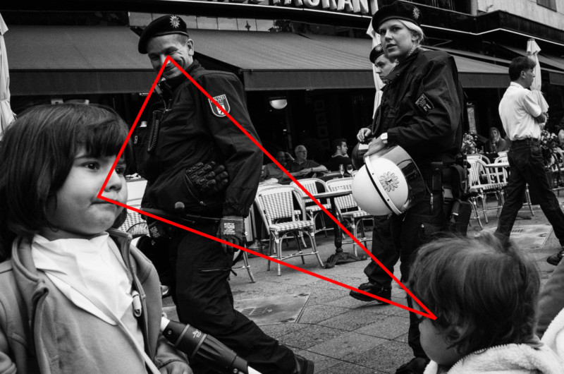
Triangles
Geometrical symbols help to control the flow of the picture. They build a basic framework for the viewer to follow, and create some dynamic movement because symbols like triangles or circles aren’t a dead end.

Slide 11
Rule of Odds
The picture in the previous slide shows an example of three subjects that form a triangle. But it’s not only three subjects that are pleasant for a viewer—5 or even 7 points of interest can increase the aesthetic value of the image tremendously.
The psychology behind this odd rule is that even subjects are easy to organize, easy to pair (2,4,6 etc.), and this is an uninteresting task for our brain.

Slide 13
Breaking Symmetry
Having a symmetrical picture is a nice achievement, but a picture that is 100% symmetrical is too easy to comprehend. In order to make it more interesting, you can simply use a subject very slightly off the sectional plane.

Slide 15
Compositional Elements & Principles
Points
Lines
Shapes
Texture
Color
Tone
Distance
Balance
Space
Patterns

Slide 16
Points
The simplest element of composition is a point.
Points are a bit deceptive; mathematically, they have zero dimensions. Photographically, we’re a bit more lenient. A point is just a small area of interest in a photo, or the intersection between areas of interest.
Stars in the sky in a photograph are “points,” and so is an out-of-focus light in the background. The same is true of the spot where two mountains meet one another, creating an intersection that pulls at the viewer’s eye.

Slide 18
Lines
lines are more like a path for a viewer to follow. Or, they are a boundary: the division between sky and ground, for example.
Like points, lines in photography are not defined as rigidly as lines in geometry. Photographically, anything that connects two parts of a photo or stretches across your composition is a line. That includes a curved road or a jagged mountain ridge, for example. Even the fuzzy, lightly defined edge of a cloud is usually a line.
Lines also serve an important function of connecting two different elements of your photo. They can give an image structure, which is a crucial part of making an image feel deliberate and intentional. A path leading from foreground to background has a way of making the image feel connected.

Slide 20
Shapes
Shapes can be anything, from the crescent moon to the shape of a smiling face. Each variety of shape has its own emotional impact on a photo, and it’s impossible to generalize. A circle might be peaceful, a heart evocative, a triangle dynamic, and so on – but the only thing to be said about every shape is that they have the power to attract our attention.
shapes are more conceptual, like a curved cloud over a curved valley that gives the entire photo a circular composition. Both types of shapes matter. The first attracts attention; the second gives the photo its structure

Slide 22
Texture
The texture of an object plays an important role in determining its emotional impact, as well as the amount of attention it draws.
Sometimes, textures themselves may be the subject of your photo, like patterns in the sand or waves of water. More often, though, textures are individual elements of a larger photo – either giving your subject some dimension or filling in the spaces between subjects.
Areas with more texture tend to draw extra attention. Sometimes, too much texture in “unimportant” areas of a photo can be distracting, making the overall photo appear too complex. In other cases, texture gives your subject a crucial sense of dimension, such as filling out the shape of a mountain landscape.

Slide 24
Color
Other than black and white photography – a creative choice of its own – color makes a big difference to the composition of a photo, as well as the mood.
Color brings its own emotions to photography, a topic that could fill far more than the small space here. Nevertheless, the most important distinction you need to know at the moment is that of warm versus cool colors.
When you’re composing your photos, recognize the colors contained within, and try to use their strengths to your advantage. Often, pairing a warm color with a cool color creates an interesting sense of contrast, leading to an eye-catching image. Similarly, photos with just one or two dominant colors present a very unified message – a message that can be highly successful if created with care.

Slide 25
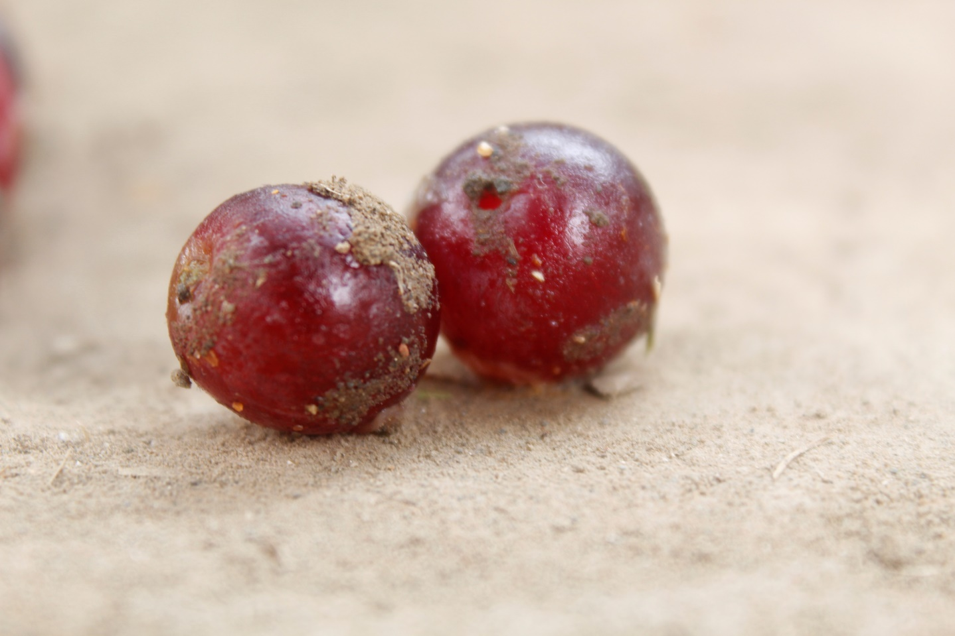

Slide 26
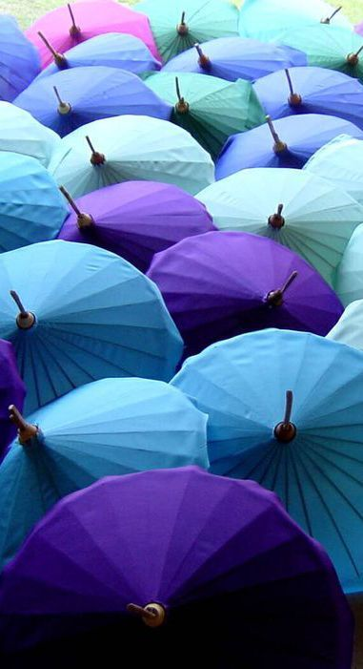

Slide 27
Tone
Another important element of composition is tone, both for individual objects and for the photograph as a whole. Although tone can refer to hues and intensity of color, it also relates to the brightness and darkness of an image, as well as its contrast.
Photographs which employ tone successfully will carry the eye through the flow of a photo – much in the same way that musical tones carry listeners through the highs and lows of a performance. The tones of a photograph also change its overall emotions. Photographs which are darker tend to obscure more of your subject, giving it a mysterious, intense, and even refined appearance. Brighter photographs are more optimistic.
So the one who’s processing the picture should pay attention to the tones of your photo, both in the field and in post-processing (editing). They control how a viewer flows through the photo, as well as the emotions the photo conveys.

Slide 29
Distance
The simplest relationship between elements of composition is the distance between them. Distance matters for a few different reasons.
If some of your subjects are too close together – or if one subject crosses another – the results can be distracting. So a photographer should adjust himself in such a way that every element has its own breathing space.
Distance also applies to the concept of shapes as mentioned earlier, or, more broadly, structure. The most common compositional structures are simply a line (connecting two areas of interest) and a triangle (three). But as you add more and more subjects, as well as playing around with the distances between them, you’ll create compositions with significantly more complex structures.

Slide 30
The composition in the photo is, roughly, a pentagon – the result of the sun and different points on the mountains being the right distance away from one another

Slide 31
Balance
The next element of composition is balance, related closely to the concept of visual weight. Visual weight isn’t complicated; it’s just the amount of attention each object in your photo attracts. Every part your photo has some amount of visual weight to it.
Balance is about the arrangement of visual weight in a photo. A balanced photo has similar levels of visual weight between the left and right halves; an imbalanced photo has more weight on one side or the other. Sometimes, a “lighter” element can balance a “heavier” element simply by being farther from the center of a photo

Slide 32
A balanced composition, where the mountain and the lake have similar levels of visual weight, and both are equidistant from the center of the image

Slide 33
Space (Positive and Negative)
Positive space is any part of the photo that attracts attention. Areas with significant visual weight are usually positive space. The same is true of areas with high levels of texture.
Negative space is the “filler” between regions of positive space. It doesn’t necessarily fade into the background like cool colors tend to do, but it isn’t the portion of the photo that attracts the most attention.
Photos with high amounts of positive space feel crowded, while photos with high amounts of negative space feel empty. Neither of these sounds like a particularly good emotion, but both can be very powerful in a photo. Positive and negative space depend quite a bit on other elements of composition, such as visual weight and distance.

Slide 35
Patterns
In photography, patterns are everywhere. This isn’t just something small like a texture that repeats itself throughout the photo, but really in any repeating element at all. Even the reflection of a mountain in a pool of water is a pattern – one which should not be underestimated, since it ties the photo together.
Patterns are said to be JOINTS. They tie photos together. They give photos a reason to exist – a strong statement for why the photographer took this photo and not some other.
Patterns are arguably more obvious in manmade scenes, like architectural photography. But even natural scenes and living creatures have patterns, like feathers on a bird or waves crossing in the sea.

